Slide 1

Oracle11g:
PL/SQL Programming
Chapter 9
Database Triggers

Slide 2
Chapter Objectives
After completing this lesson, you should be able to understand:
  Database triggers and syntax
  How to create and test a DML trigger
  How to create and test an INSTEAD OF trigger
  Applying other triggers
  Identifying when triggers should be used
Oracle11g: PL/SQL Programming

Slide 3
Chapter Objectives (continued)
After completing this lesson, you should be able to understand (continued):
  Using compound triggers
  Setting the firing order of triggers
  Using the ALTER TRIGGER statement
  Deleting a trigger
  Using data dictionary information relevant to triggers
Oracle11g: PL/SQL Programming

Slide 4
Database Trigger Defined
Triggers are similar to procedures and functions but will execute automatically based on an event
Events are either DML statements or database system actions
Triggers will fire regardless of the source of the event
DML triggers are specifically associated with a table or view
Oracle11g: PL/SQL Programming

Slide 5
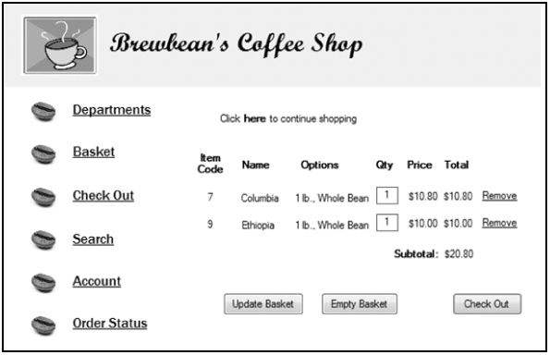
Brewbean’s Challenge
Update product inventory upon order completion
Oracle11g: PL/SQL Programming

Slide 6
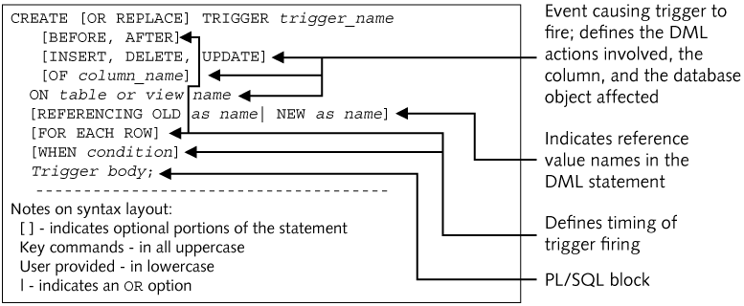
Create DML Trigger Syntax
Oracle11g: PL/SQL Programming

Slide 7
Example Trigger
1 CREATE OR REPLACE TRIGGER product_inventory_trg
2 AFTER UPDATE OF orderplaced ON bb_basket
3 FOR EACH ROW
4 WHEN (OLD.orderplaced <> 1 AND NEW.orderplaced = 1)
5 DECLARE
6 CURSOR basketitem_cur IS
7 SELECT idproduct, quantity, option1
8 FROM bb_basketitem
9 WHERE idbasket = :NEW.idbasket;
10 lv_chg_num NUMBER(3,1);
11 BEGIN
12 FOR basketitem_rec IN basketitem_cur LOOP
13 IF basketitem_rec.option1 = 1 THEN
14 lv_chg_num := (.5 * basketitem_rec.quantity);
15 ELSE
16 lv_chg_num := basketitem_rec.quantity;
17 END IF;
18 UPDATE bb_product
19 SET stock = stock – lv_chg_num
20 WHERE idproduct = basketitem_rec.idproduct;
21 END LOOP;
22 END;
Oracle11g: PL/SQL Programming

Slide 8
Trigger Timing
AFTER or BEFORE event
ROW level or STATEMENT level
WHEN clause provides conditional processing
Oracle11g: PL/SQL Programming

Slide 9
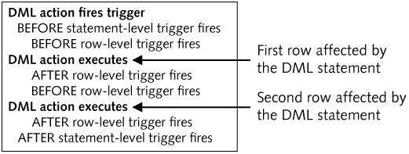
Trigger Timing
Oracle11g: PL/SQL Programming

Slide 10
Trigger Event
INSERT, UPDATE, DELETE
  Use the OR operator to include more than one event in a trigger
OF column_name option
ON table_name
Oracle11g: PL/SQL Programming

Slide 11
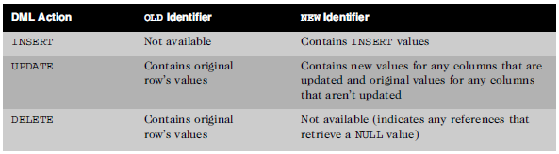
Correlation Identifiers
Special bind variables associated with DML activity
OLD and NEW by default
Oracle11g: PL/SQL Programming

Slide 12
Trigger Body
PL/SQL block
Must include a DECLARE clause if declarations needed
Can reference correlation identifiers using a preceding colon
Can include calls to other program units
Oracle11g: PL/SQL Programming

Slide 13
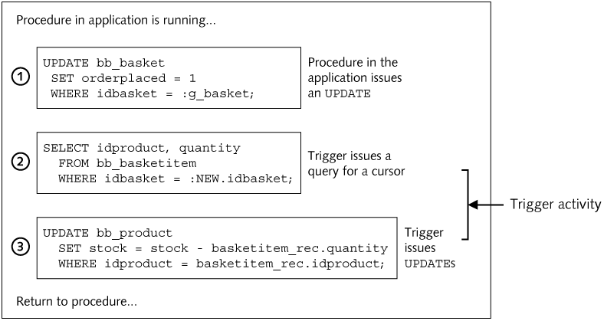
Trigger Processing Flow
Oracle11g: PL/SQL Programming

Slide 14
Conditional Predicates
IF INSERTING, IF UPDATING, IF DELETING
Supports different processing to occur for each type of DML statement since multiple DML actions can fire a trigger
Can specify a specific column also:
IF UPDATING (‘lastname’) THEN…
Oracle11g: PL/SQL Programming

Slide 15
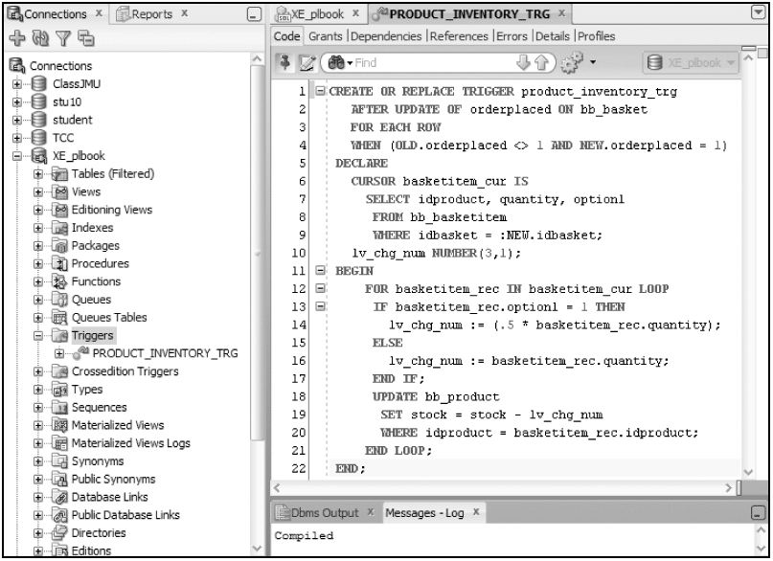
Create Trigger
Oracle11g: PL/SQL Programming

Slide 16
Instead Of Trigger
Workaround for nonmodifiable view limitations
DML activity on a view will fire an Instead Of trigger
DML activity in the trigger will execute against the base tables using values from the triggering event
Oracle11g: PL/SQL Programming

Slide 17
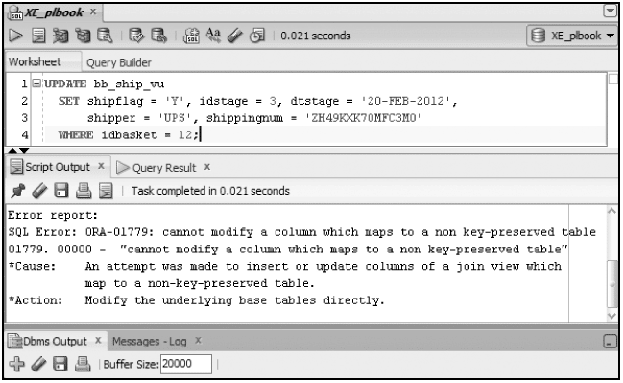
Instead Of Example
Oracle11g: PL/SQL Programming

Slide 18
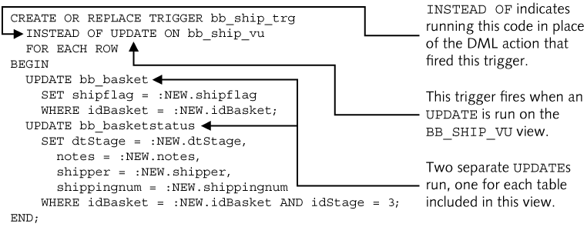
Instead Of Example
Oracle11g: PL/SQL Programming

Slide 19
System Triggers
DDL and database system events
CREATE
RENAME
COMMENT
ALTER
TRUNCATE
ASSOCIATE STATISTICS
DROP
ANALYZE
DISASSOCIATE STATISTICS
GRANT
AUDIT
REVOKE
NOAUDIT
Oracle11g: PL/SQL Programming

Slide 20
System Trigger Syntax
CREATE [OR REPLACE] TRIGGER trigger_name
[BEFORE, AFTER]
[List of DDL or Database System Events]
[ON DATABASE | SCHEMA]
Trigger body;
ON DATABASE – will cause trigger to fire regardless of schema in which the trigger event originated
ON SCHEMA – only fires when event occurs in the same schema in which the trigger was created
Oracle11g: PL/SQL Programming

Slide 21
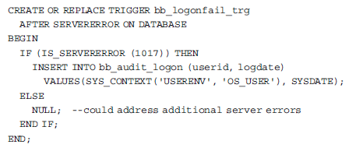
System Trigger Example
Capture failed login attempt information
Oracle11g: PL/SQL Programming

Slide 22
Applying Triggers
Task Type
How a Trigger May be Applied
Auditing
Log files of database activity are widely used. An example would be tracking sensitive data modifications such as employee payroll data. A trigger could be used to write the original and new values of the employee salary update to an audit table. If any questions arise concerning the change, a record of the original values and new values assigned is now available.
Data integrity
Simple data validity checks can be accomplished with CHECK constraints. However, more complex checks or checks that require comparison to a live data value from the database can be accomplished using triggers. A trigger could be used to ensure that any changes to the regular price of a product do not allow a decrease from the current price. The NEW and OLD price values can be compared in a trigger.
Referential integrity
Foreign key constraints are used to enforce relationships between tables. If a parent key value is modified, such as a department number, a foreign key error occurs if we still have products assigned to that department. Triggers provide a way to avoid this error and accomplish a cascade update action.
Oracle11g: PL/SQL Programming

Slide 23
Applying Triggers (continued)
Task Type
How a Trigger May be Applied
Derived data
We may have columns that hold values that are derived from using other columns in a calculation. For example, Brewbean's may have a product sales summary table that holds the total quantity and dollar sales by product. If this table needs to be updated in real time, then a trigger could be used. Every time a new sale is recorded, the trigger would fire and add the new sales amounts to the totals in the sales summary table.
Security
Additional checks on database access can be accomplished such as a simple check on the time of user logon. Some companies use a trigger to determine if it is a weekend day; if so, access is denied. In this case, the company identifies any weekend access as suspicious. (Don’t we wish all companies were like this?!!)
Oracle11g: PL/SQL Programming

Slide 24
Compound Triggers
Avoid table mutation issues with triggers
Introduced in Oracle11g
Allow combining all four triggering events into a single trigger
Allows the different events to share variables
Oracle11g: PL/SQL Programming

Slide 25
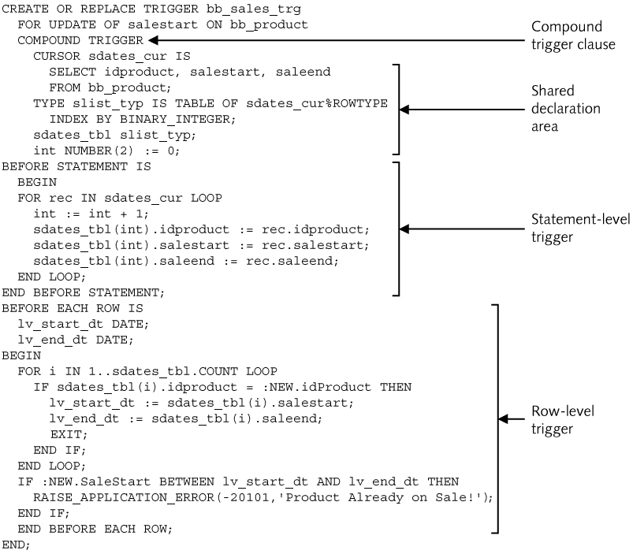
Compound Triggers
Oracle11g: PL/SQL Programming

Slide 26
Restrictions on Triggers
Cannot issue transaction control statements
Cannot use LONG or LONG RAW data types
Mutating Table error – attempt to modify a table in a row level trigger that is already being modified by the firing event
Constraining table – table referenced via a foreign key of the table being modified in a trigger firing event
Oracle11g: PL/SQL Programming

Slide 27
Trigger-firing Order
Prior to Oracle11g, multiple triggers firing on the same firing level (such as before statement level) had no guaranteed order
Oracle11g introduced the FOLLOWS and PRECEDES options to control the firing order of DML triggers
Oracle11g: PL/SQL Programming

Slide 28
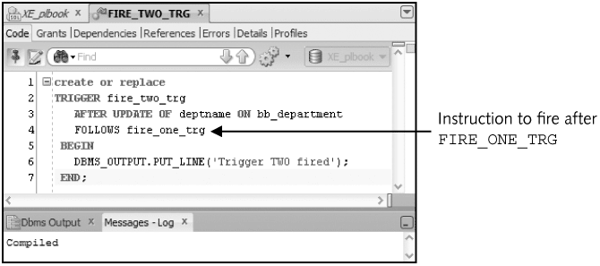
Trigger-firing Order
Oracle11g: PL/SQL Programming

Slide 29
ALTER TRIGGER statement
Used to compile or disable/enable a trigger
ALTER TRIGGER trigger_name COMPILE;
ALTER TRIGGER trigger_name DISABLE|ENABLE;
ALTER TABLE table_name DISABLE|ENABLE ALL TRIGGERS;
Oracle11g: PL/SQL Programming

Slide 30
Delete a Trigger
DROP TRIGGER trigger_name;
Note: If a table or view is dropped, any associated DML triggers will automatically be deleted
Oracle11g: PL/SQL Programming

Slide 31
Data Dictionary
Same as other program units except for viewing the source code
  USER_TRIGGERS to view trigger source code
Description column contains the header code
Trigger_body column contains the body code
Oracle11g: PL/SQL Programming

Slide 32
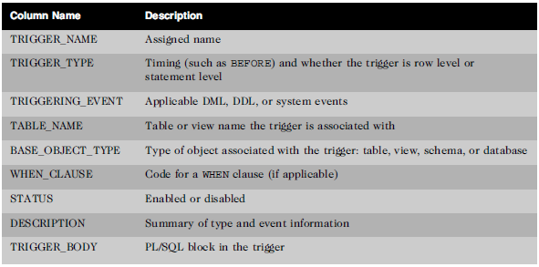
Data Dictionary
USER_TRIGGERS columns
Oracle11g: PL/SQL Programming

Slide 33
Summary
Database triggers fire implicitly based on a DML event or a system event
Timing options include BEFORE, AFTER, ROW, and STATEMENT level
WHEN clause provides conditional processing of a trigger
Correlation identifiers allow referencing values involved in the DML action
Conditional predicates allow different processing for each type of DML action
Oracle11g: PL/SQL Programming

Slide 34
Summary (continued)
Instead Of triggers provide a mechanism to handle DML activity on nonmodifiable views
Compound triggers allow combining multiple trigger events into a single trigger
The FOLLOW and PRECEDES options enable control of the firing order of DML triggers
The ALTER TRIGGER command allows a trigger to be compiled or ENABLED/DISABLED
The USER_TRIGGERS data dictionary view allows the display of trigger code
Oracle11g: PL/SQL Programming

